Slide 1
Hackit Presentation
.Predict()
Team: 10
Project: .Predict()

Slide 2
Deep Neural Network Call Routing (Commercial)
Step One
Collect Data (IVR, Voice, Agent, Survey)
Step Two
Train and Test Network
Step Three
Plug Neural Network into GVP (Genesys Voice Platform)
Step Four
Profit!

Slide 3
Creativity- Originality
Does this solution consider a new problem and provide an original solution?

Slide 4
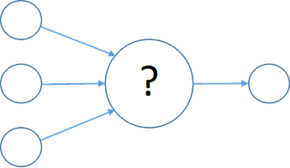

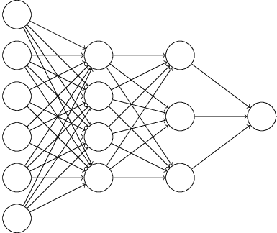

Classic Routing VS Deep Neural Network Routing
Classic Routing
Does not take real time action based on previous Days/Months/Years Events & Data
Takes no action to promote positive Net Promoter Score (NPS)
Does nothing to reduce Average Handle Time (AHT)
Creates a nearly random Client Experience (CX)
Deep Neural Network Routing (DNN)
Relearns everything it knows every day from any range of history so it may make the best possible decisions
Trained properly, DNN promotes positive NPS and lowers AHT
Creates intelligent and consistent CX

Slide 5
Creativity- Innovation
Does this solution introduce new technology, innovation, and/or an innovative approach?

Slide 6
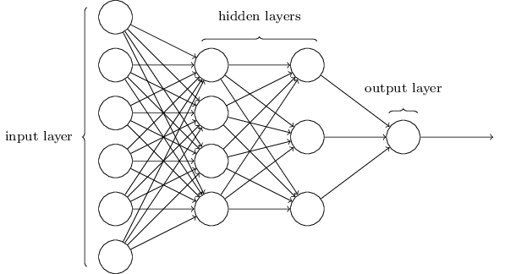
Deep Neural Networks (Data Science)
Regular Supervised and Unsupervised Training
DNNs re-train themselves hourly based on historical data to constantly remain relevant and accurate.
DNNs continue to remember old anomalies and their resolutions, while learning new solutions from new anomalies that present.
Inferencing takes only microseconds

Slide 7
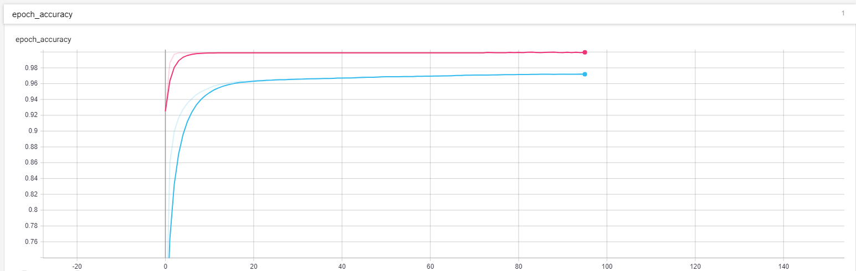
Training (Data Science)
Network Training (95 Epoch)
Pink = Testing Validation w/ Validation Data
Blue = Training Validation w/ Training Data

Slide 8
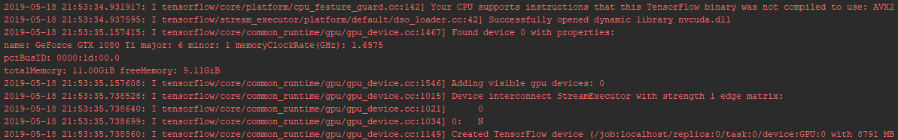
Training (Data Science)
Training on GTX 1080 Ti

Slide 9
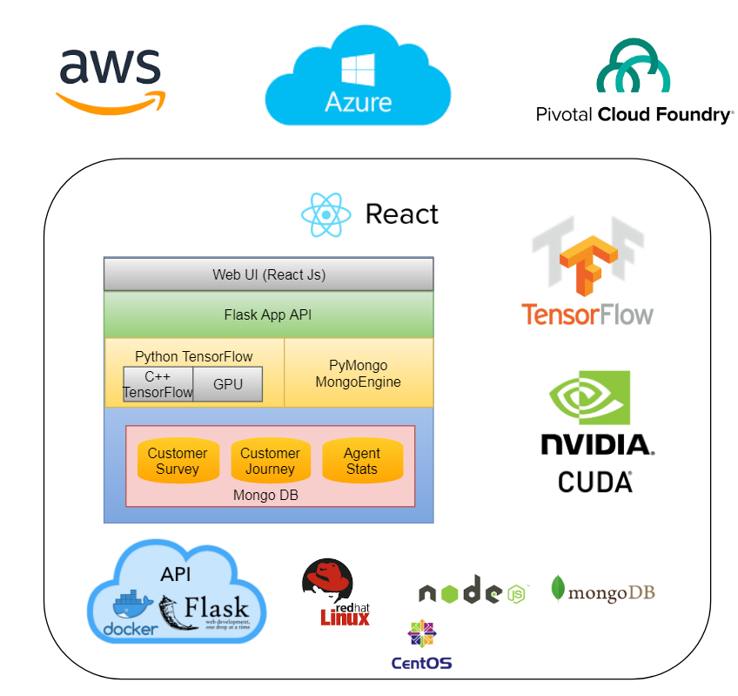
Containers (Cloud/On-Prem)
All packed up and ready to ship!
Docker Containerized with:
Python
Node/React
Tensorflow/Tensorboard
Can ship to:
PCF
AWS
Azure
VM
Etc…

Slide 10
Market- Client First
How does this product meet the needs of the client?

Slide 11
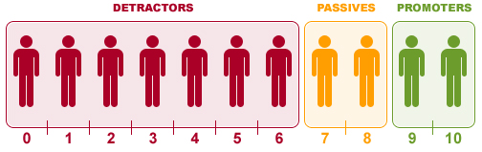
Contact Centers (Voice/SMS Interfaces)
Clients Purchase Contact Center Elevated Experience (C2E2) from First Data
Using the latest features available in Python 3/Tensorflow/Keras
Build a Deep Neural Network (DNN) conduct supervised training on:
The client experience and intent of existing IVR applications
The client experience and intent of agents
The NPS and survey results
Enables us to:
Predict NPS and AHT prior to routing the call to agents
Route those calls to the strategic target agent yielding improved CX and AHT

Slide 12
Market- Future Product
Is this product easy to bring to market and providing business value?

Slide 13
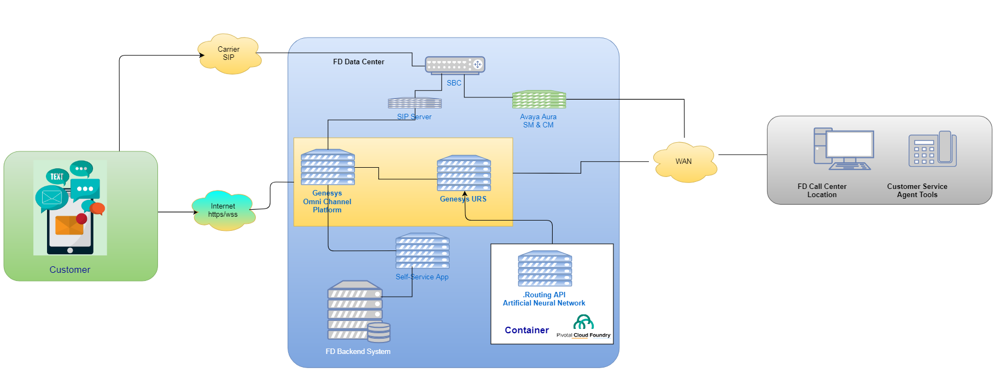
Plug, Train and Play
Appending this Solution to the end of existing IVR applications provide you with DNN features.

